Slide 1
Analytical Geometry and Linear Algebra 1
Rank
Strategy for efficient exam solving
Test 1 solutions

Slide 2
Цели пары
В прошлом году тут не давали ранг матрицы, но я перенес, чтобы была выше посещаемость на лабе

Slide 3
Questions from the class
No questions for today

Slide 4


Slide 5


Slide 6


Slide 7
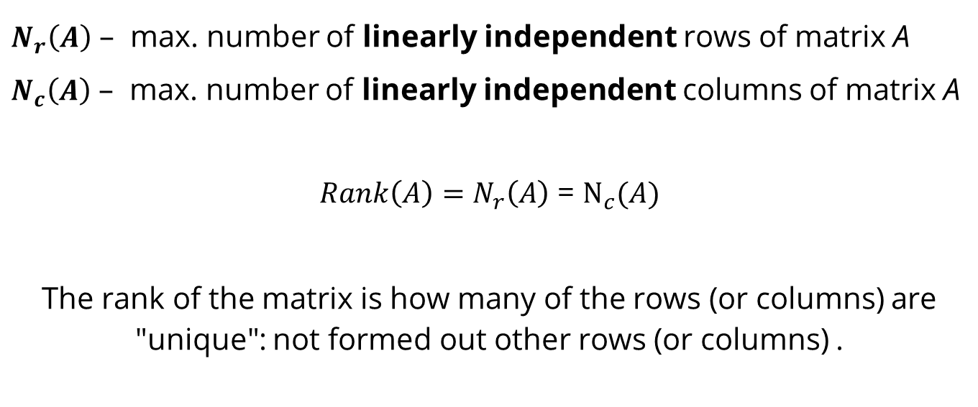
Matrix rank: definition

Slide 8
Matrix rank: motivation
Computation of the number of solutions of a system of linear equations.
Analysis of the linear dependency of rows and columns
Applications in Control Theory (next year): observability and controllability

Slide 9
matrix rank: how to find
There are 3 ways:
Look at matrix and find linear dependencies
Reduced form (transform matrix to triangular form) (using Gaussian approach for finding inverse matrix)
Minor method (метод окаймляющих миноров) not popular in western education

Slide 10
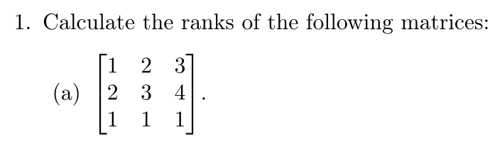
Matrix rank: task 1: answer = 2

Slide 11
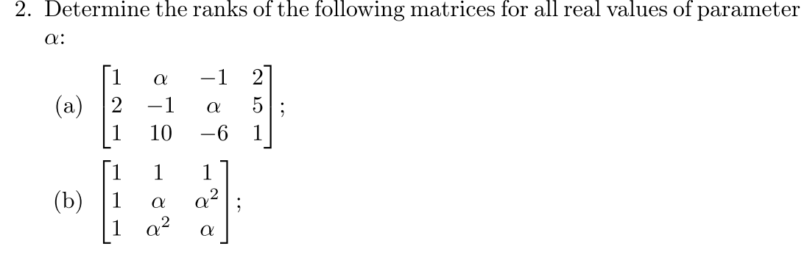
Matrix rank: task 2

Slide 12
Exam / test
Preparation before test
Preparation in a day of test
Behavior on exam

Slide 13
Strategy for efficient exam solving
Problem: During exam, spend too much time on finding the solution
Solution: Find the right strategy for preparation and behavior during an exam.
Approx time consument:
Preparation: 3-8 hours in overall
Exam:
find the idea how to solve — 10 sec - 2 min
implement it — 10-20 min

Slide 14
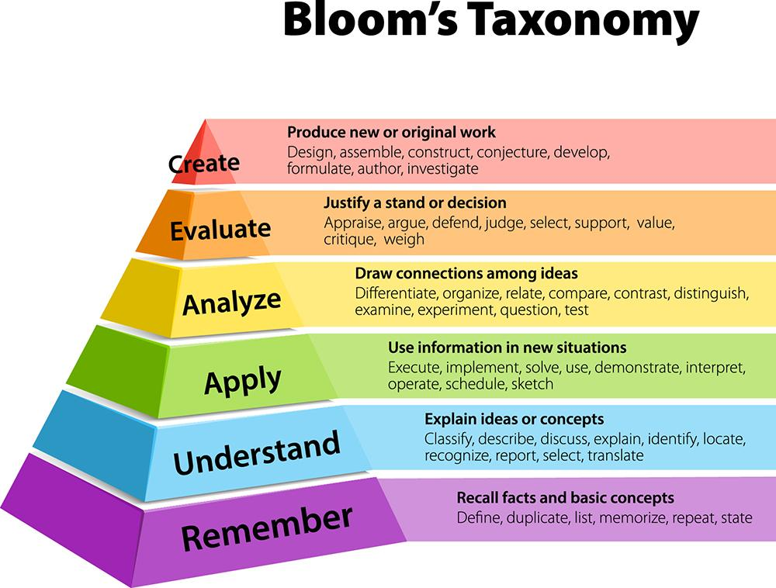
Preparation strategy
Understand the concept of a new topic (Apply or Analyze in terms of Bloom’s Taxonomy)
Look at slides and videos
Play with concept (suggest some ideas and prove it or disprove via computer or hand calculations)
Take a book (material) with exercises and solutions for it.
Look at the task, imagine how to solve it.
Check it from solutions. If you sure that your solution is also applicable – check it.
For some tasks practical skills are important (find not only an idea, but implement it)!
Wiki page

Slide 15
Behavior on and before exam
Before: Prepare your brain (skim the material) and mentality (by self hypnosis techniques) (science russian book “Преодолей себя! Психическая подготовка в спорте”)
During an exam:
Ranking tasks by doing speed
Can solve on-a-fly (expect max grade)
Easy concept – tough implementation (expect that some computational mistakes can be done)
Tough concept (cannot find the solution on-a-fly) (time consuming tasks)
Solve it in these order
…
Profit

Slide 16
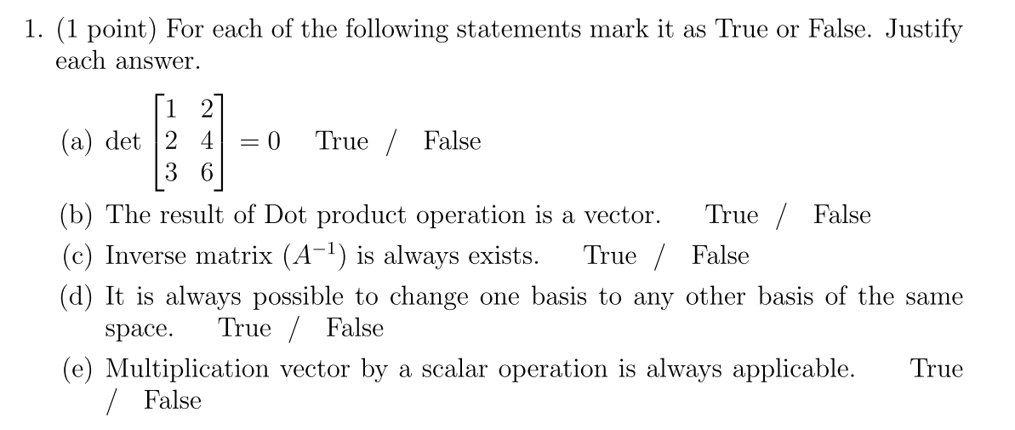
Task 1

Slide 17
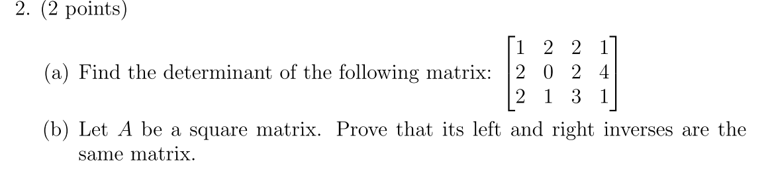
Task 2

Slide 18
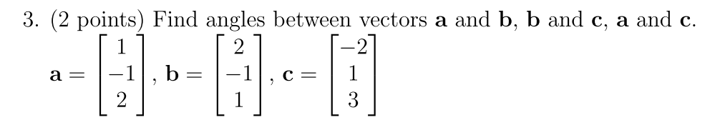
Task 3

Slide 19
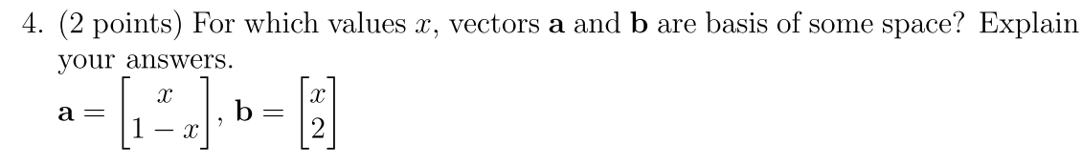
Task 4

Slide 20
Task 5

Slide 21


Slide 22
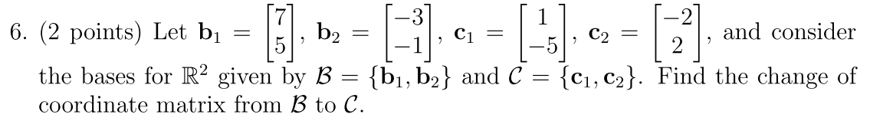
Task 6

Slide 23
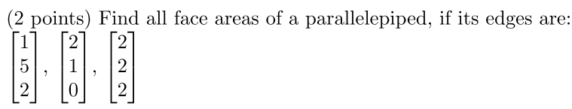
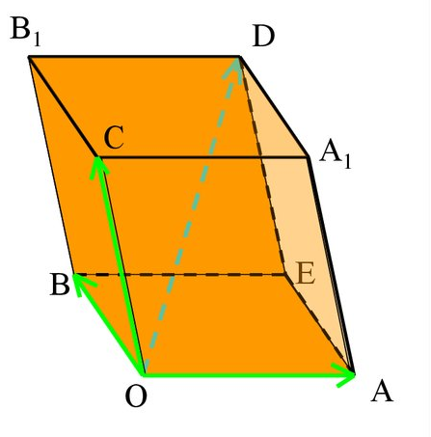
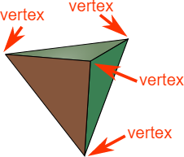
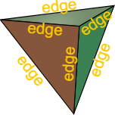
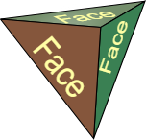
Task 7 (1)
Vertices, edges and faces
Parallelepiped

Slide 24
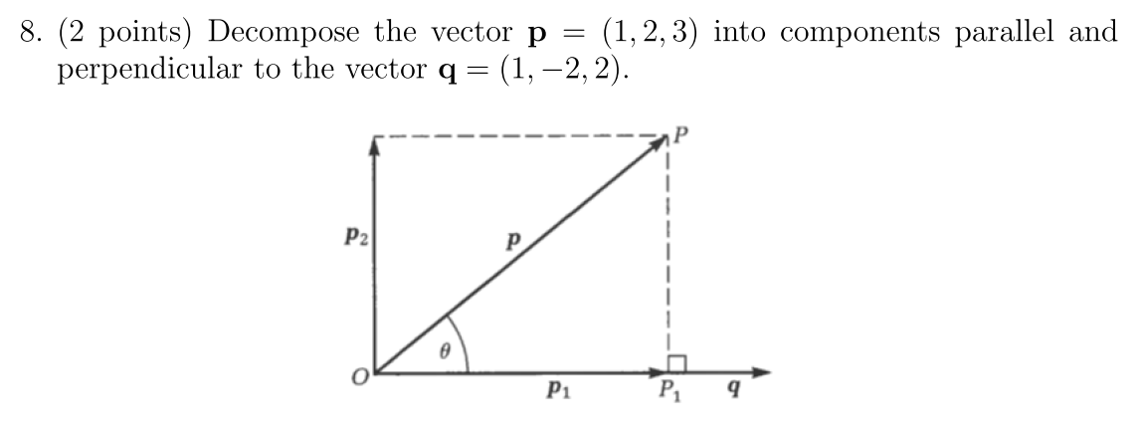
Task 8

Slide 25
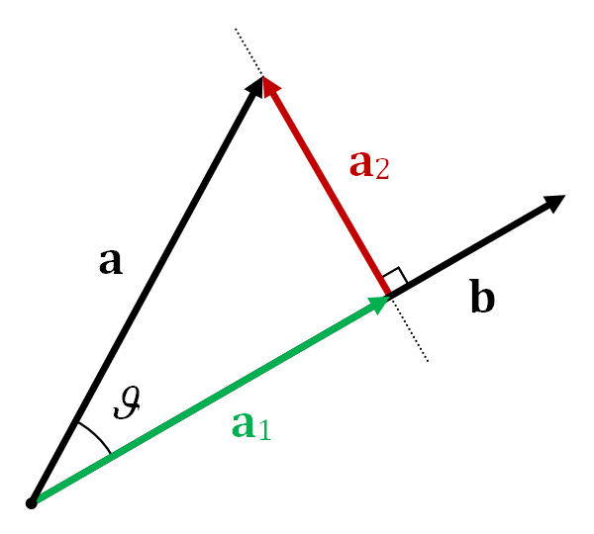
Projection (1)
Def: Projection
Where it can be used:
Maps
Blueprints
Fitting algorithms (Least squares)
Reduce matrix dimension
Links:
MIT 15 lecture

Slide 26
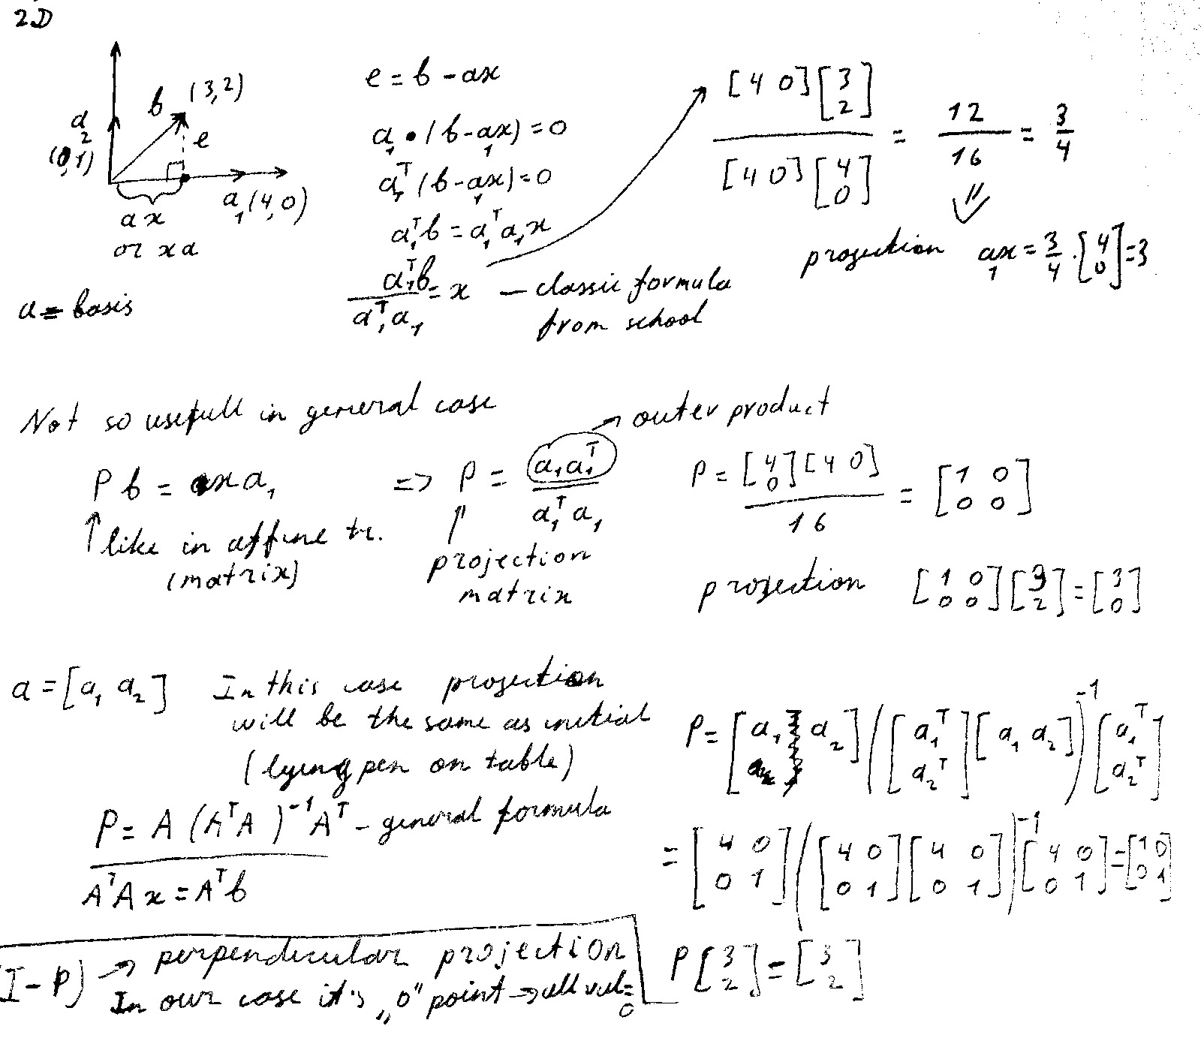
Projection 2D case from school
Proofing 2d case formula (we project “b” on “a₁”)

Slide 27
2D case, using Projection matrix
The same task, but using more general approach (projection matrix)

Slide 28
Proj. general case formula + example
The same picture, a = [a₁ a₂] , P here is general formula for N space

Slide 29
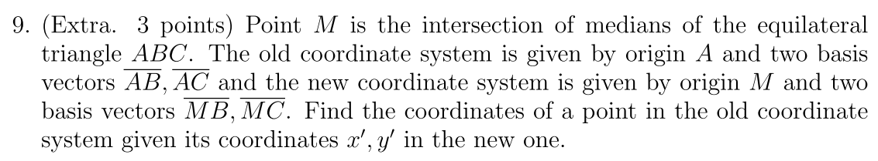
Task 9
Solution

Slide 30
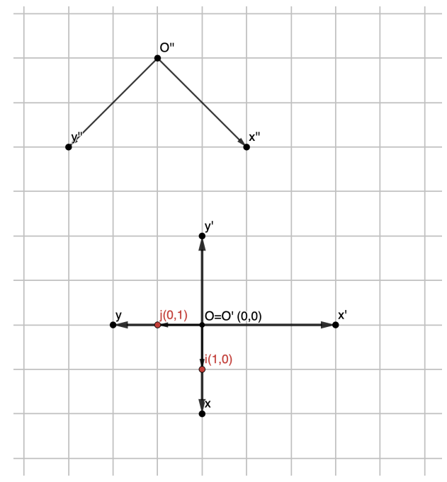
Task 6*
Task 6

Slide 31
Deserve “A” grade!
– Oleg Bulichev

